Slide 1
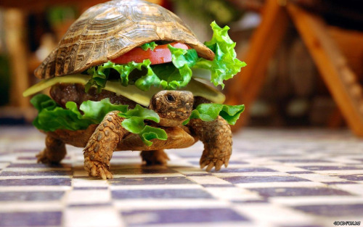
Social benefits of slow food
Group 4 Project Katarina, Kirana, Adrien, Cyril, Thibaud

Slide 2
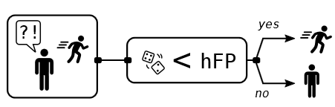
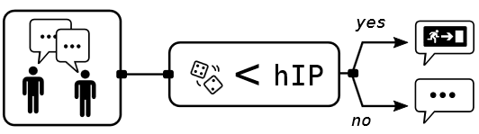
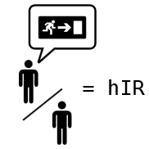
Question
Cooperation imply costs…
… what is the social benefit of cooperating against zombies?

Slide 3
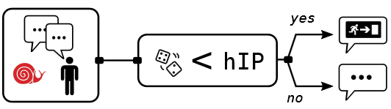



Question
Cooperation imply costs…
… what is the social benefit of cooperating against zombies?
hIp1 > hIp
hIp1
hRs = 0.49
= 0
= 1
hRs1 < hRs

Slide 4
Modification of the code
ScalaTask("""
import zombies._
val agents =
(0 until nbSlow).map(_ => Human(informProbability = hIp1, runSpeed = hRs1, informed=true))
val rng = Random(seed)
val result = zombieInvasion(
zombies = 4,
humans = 250 - nbSlow, // with default values
agents = agents,
steps = 500,
random = rng,
humanInformedRatio=0.0)
val rescuedDynamic = result.rescuedDynamic()
val rescuedDynamicSlow = result.filteredRescuedDynamic(runSpeed = Some(_ < 0.3))
val rescuedDynamicFast = result.filteredRescuedDynamic(runSpeed = Some(_ >= 0.3))
""")
Creation of slow food
Modified the informed agents
Three parameters to explore
Filtering of rescuedDynamic (thanks Romain!)

Slide 5

Exploratory analysis 1
Direct sampling
nbSlow in (0 to 125 by 25) (Number of )
hRs1 in (0.1 to 0.4 by 0.1) (Run speed of )
hIp1 in (0.1 to 1.0 by 0.1) (P(inform) of )

Slide 6





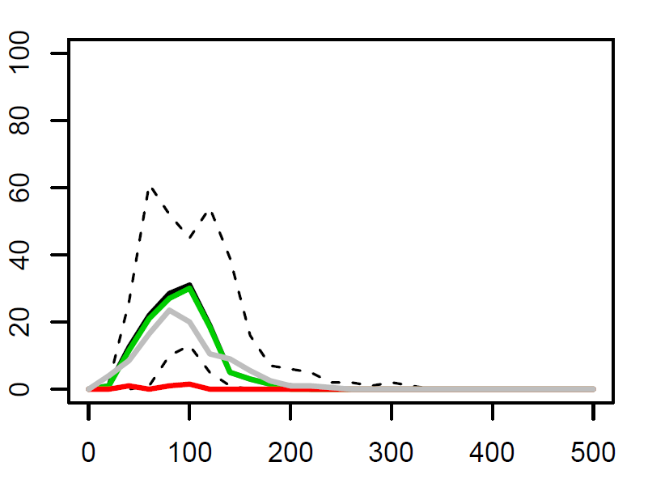
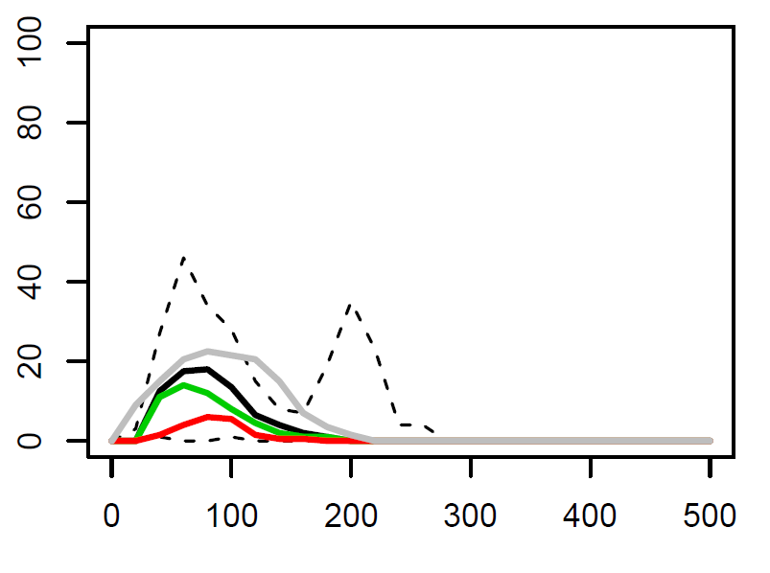
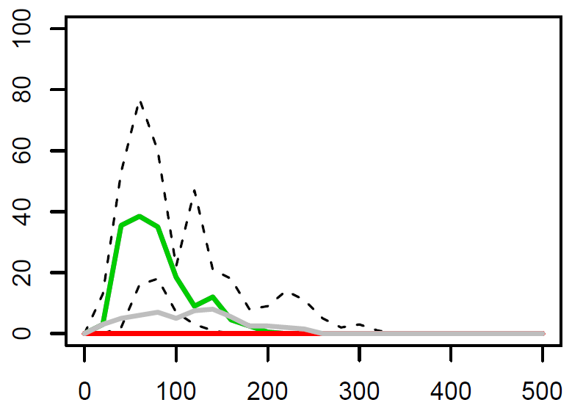
Results 1
All
Rescued
No
25
Zombified
Best situation
50
hIp1 = 0.7
hRs1 = 0.4
125

Slide 7
Exploratory analysis 2
Genetic algorithm
nbSlow in (0 to 125)
hRs1 in (0.1 to 0.4)
hIp1 in (0.1 to 1.0)
(not on local!)

Slide 8
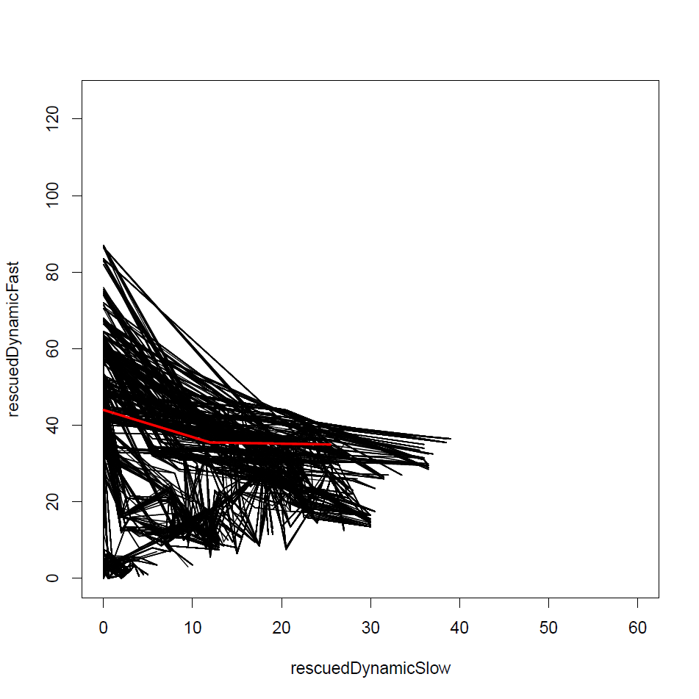
Results 2
Population 2155
nbSlow hRs1 hIp1 rescuedDynamicFast rescuedDynamicSlow
72 0.379 0.559 44.0 0.0
83 0.219 0.525 35.5 12.0
121 0.274 0.843 35.0 25.5
Population 10000
nbSlow hRs1 hIp1 rescuedDynamicFast rescuedDynamicSlow
118 0.292 0.840 26.5 0.0
40 0.396 0.773 56.5 12.0
121 0.274 0.843 37.5 25.5
Notes:
2155 generations

Slide 9
Conclusion
Importance of information (No information = All zombified)
Benefits and costs in cooperation do not impact the same people here (the slow incur the costs vs. the fast benefits)
Convergence is noisy because of stochasticity in the model
Does anyone volunteer to become slow food and save the world?

Slide 10
Thank You
Acknowledgement:
ExModelo Team
Github: pioucyril/exmodeloGroup4

